Slide 1







2nd International Conference on
Advances in Technology and Management (ICATM -2024)
April 5-6, 2024
--------------------------------------------------------------------------------------------------------------------------------------------------------------
Organized by
A. C. Patil College of Engineering & Management,
Kharghar, Navi Mumbai
www.acpce.org

Slide 2
2nd International Conference on
Advances in Technology and Management (ICATM -2024)
April 5-6, 2024
--------------------------------------------------------------------------------------------------------------------------------------------------------------
PAPER ID: 284 VIRTUAL REALITY HORROR GAME
AUTHOR’S NAME 1. SHRUTI SABBANI
2. RITVIK BABRE
3. HITESH BEHERA
4. SWAPNIL YADAV
5. PUNAM BAGUL

Slide 3
2nd International Conference on
Advances in Technology and Management (ICATM -2024)
April 5-6, 2024
--------------------------------------------------------------------------------------------------------------------------------------------------------------
Outline
Introduction
Literature Review
Problem Definition/ Objective
Methodology
Results and Discussions
SWOT Analysis
Conclusion/Future Scope
References

Slide 4
2nd International Conference on
Advances in Technology and Management (ICATM -2024)
April 5-6, 2024
--------------------------------------------------------------------------------------------------------------------------------------------------------------
Introduction
Virtual reality (VR) horror games offer an unparalleled immersion by leveraging first-person perspective, realistic graphics, and interactive gameplay. Players experience the game world through the eyes of the protagonist, enhancing the feeling of presence and intensifying the horror experience. Detailed environments, coupled with atmospheric lighting, create a sense of dread, while interactivity allows players to manipulate objects and solve puzzles. Jump scares are effectively utilized to startle players, taking advantage of the heightened sense of immersion in VR. Compelling narratives further engage players, drawing them deeper into the terrifying world of VR horror gaming.
VR horror game
immersive environment
promote VR

Slide 5


2nd International Conference on
Advances in Technology and Management (ICATM -2024)
April 5-6, 2024
--------------------------------------------------------------------------------------------------------------------------------------------------------------
Introduction

Slide 6
2nd International Conference on
Advances in Technology and Management (ICATM -2024)
April 5-6, 2024
--------------------------------------------------------------------------------------------------------------------------------------------------------------
Introduction
Why opted for Horror Genre ?
Horror genre consistently rank highly across demographics and gaming platforms, showcasing their widespread appeal and engagement. Horror games excel in delivering an immersive experience that truly transports users to another world, creating a sense of fear and suspense that showcases VR's capabilities effectively. The use of spatial audio further enhances this sense of immersion, drawing players deeper into the game environment. In India, where horror stories and supernatural themes hold cultural significance, VR horror games have the potential to resonate strongly with audiences across all demographics who are enthusiastic consumers of horror content. By leveraging the universal appeal and emotional impact of horror games, VR technology can be effectively promoted and embraced as a powerful medium for immersive experiences and storytelling in the future.
widespread appeal
powerful medium
thrill & adrenaline

Slide 7
2nd International Conference on
Advances in Technology and Management (ICATM -2024)
April 5-6, 2024
--------------------------------------------------------------------------------------------------------------------------------------------------------------
Literature Review
Level of Fear, 2018
Categorize fear levels
Analysis of the design aesthetics and player emotions of horror games, 2022
Players' experience levels
Level of Fear, 2018
Categorize fear levels
Horror Game Design, 2020
Game level design patterns
Virtual Reality Horror Games and Fear in Gaming, 2023
Psychological aspects of horror games
So scary, yet so fun, 2018
potential in handling fear influences enjoyment
Adaptive virtual reality horror games based on Machine learning and player modeling, 2022
Dynamic adjustment based on behavior
Research on the Progress of VR in Game, 2023
Recent trends
Research on the Application of VR in Games, 2023
Current technological advancements and potential

Slide 8
2nd International Conference on
Advances in Technology and Management (ICATM -2024)
April 5-6, 2024
--------------------------------------------------------------------------------------------------------------------------------------------------------------
Problem Definition
Virtual reality (VR) is an emerging technology that has the potential to revolutionize the way we interact with games and other experiences. However, VR is still relatively new and expensive, and many people lack the understanding of how it works. This limits the reach of VR technology and prevents it from becoming an integral part of our lives.
One way to introduce VR technology to a wider audience is to develop VR games. Gaming being one of the biggest industries in the world will allow VR to get a platform where it can showcase its endless possibilities to the world. Horror Games are some of the biggest games in the industry as they allow the player to get immersed with the environment. This makes the horror genre one of the best genres to showcase the capability of VR.

Slide 9
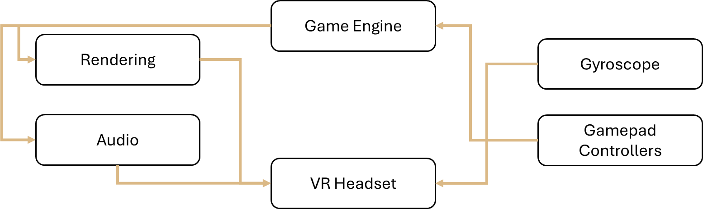
2nd International Conference on
Advances in Technology and Management (ICATM -2024)
April 5-6, 2024
--------------------------------------------------------------------------------------------------------------------------------------------------------------
Methodology

Slide 10
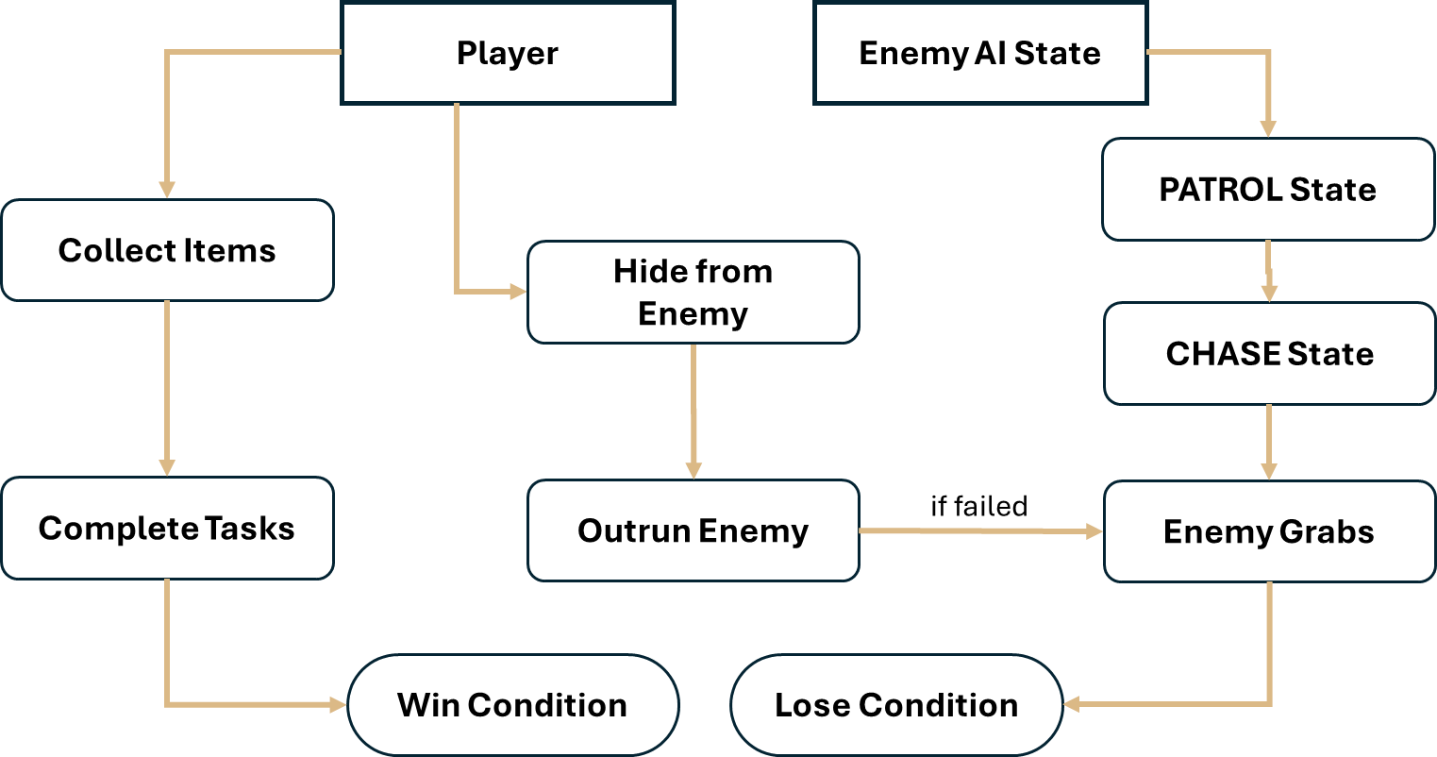
2nd International Conference on
Advances in Technology and Management (ICATM -2024)
April 5-6, 2024
--------------------------------------------------------------------------------------------------------------------------------------------------------------
Methodology

Slide 11
2nd International Conference on
Advances in Technology and Management (ICATM -2024)
April 5-6, 2024
--------------------------------------------------------------------------------------------------------------------------------------------------------------
Methodology
Google Cardboard SDK: Integrates VR functionalities on Android devices, including stereoscopic rendering and headtracking.
Gyroscope: Utilizes sensor data to track players' head movements, enhancing immersion.
Item Spawner: The algorithm enhances game replayability by randomly spawning items from strategically positioned points across the map.
Audio Management: Implements 3D spatial audio, ambient music, and eerie sounds for a heightened atmosphere.
User Interface (UI): VR-friendly UI elements provide essential information and enhance player interaction.

Slide 12
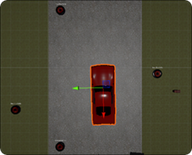
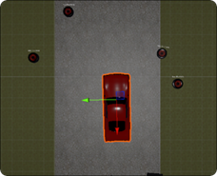
2nd International Conference on
Advances in Technology and Management (ICATM -2024)
April 5-6, 2024
--------------------------------------------------------------------------------------------------------------------------------------------------------------
Results & Discussion
Item Spawning at Random Spots

Slide 13
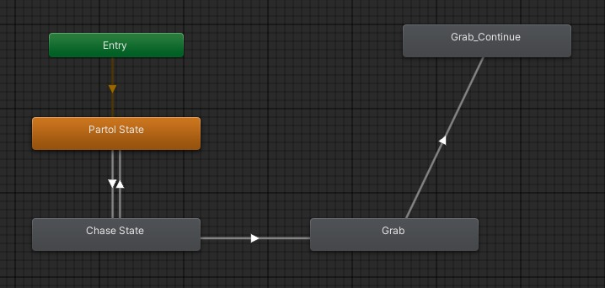
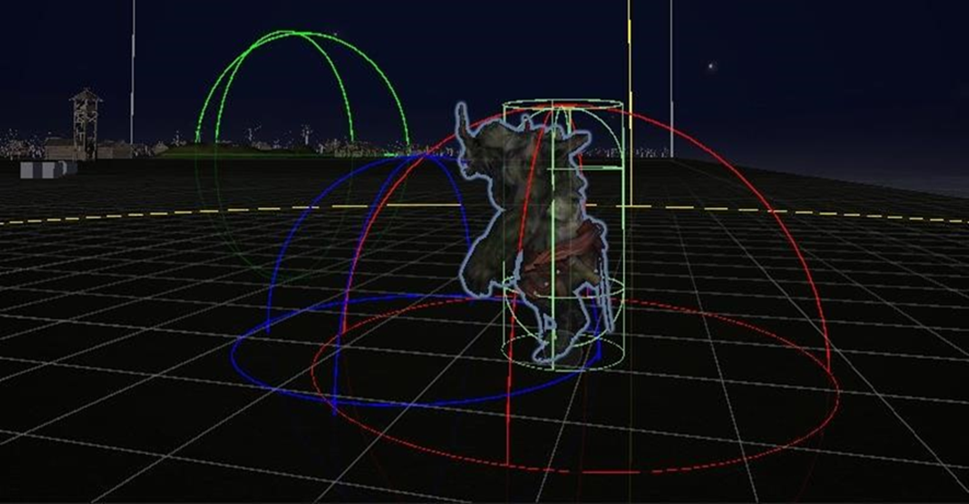
2nd International Conference on
Advances in Technology and Management (ICATM -2024)
April 5-6, 2024
--------------------------------------------------------------------------------------------------------------------------------------------------------------
Results & Discussion
Enemy <Animator> Component
Enemy in PATROL State

Slide 14
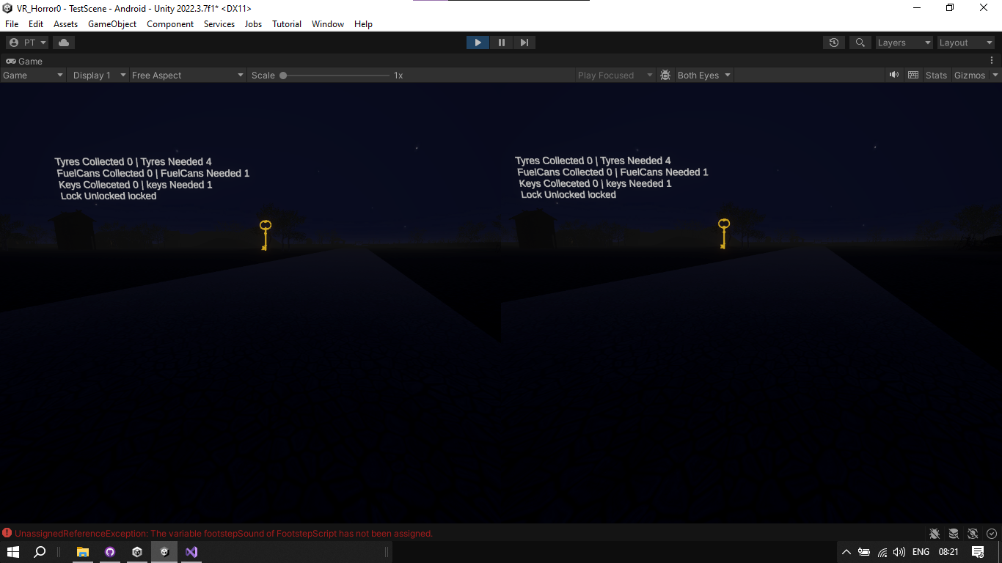
2nd International Conference on
Advances in Technology and Management (ICATM -2024)
April 5-6, 2024
--------------------------------------------------------------------------------------------------------------------------------------------------------------
Results & Discussion
Stereoscopic Game Interface

Slide 15
2nd International Conference on
Advances in Technology and Management (ICATM -2024)
April 5-6, 2024
--------------------------------------------------------------------------------------------------------------------------------------------------------------
SWOT Analysis
Strengths:
Immersive Experience
Gameplay Mechanics
Market Demand
Weakness:
Hardware Dependency
Motion Sickness
Cost of Entry
Opportunities:
Expanding VR User Base
Gameplay Features
Cross-Platform Integration
VR Community Engagement
Threats:
Innovation
Health Concerns
Economic Factors

Slide 16
2nd International Conference on
Advances in Technology and Management (ICATM -2024)
April 5-6, 2024
--------------------------------------------------------------------------------------------------------------------------------------------------------------
Conclusion
Our VR horror game incorporates a holistic approach to gaming, seamlessly blending immersive environments with advanced technology while catering to the traditional enthusiasm for consuming horror stories. It represents a fusion of past, present, and future elements, presenting VR seamlessly into daily life experiences. Adhering to VR rules and integrating cohesive features, our game sets a new standard for immersive entertainment.
introducing interactive computing
integration into day-to-day life
blending past-present-future

Slide 17
2nd International Conference on
Advances in Technology and Management (ICATM -2024)
April 5-6, 2024
--------------------------------------------------------------------------------------------------------------------------------------------------------------
Future Scope
w.r.t. VR
w.r.t. Game
Limitations of VR
Reduce Motion Sickness
Dynamic Mechanics
Multiplayer
DLC
Optimization
Community

Slide 18
2nd International Conference on
Advances in Technology and Management (ICATM -2024)
April 5-6, 2024
--------------------------------------------------------------------------------------------------------------------------------------------------------------
References
Ntokos, Konstantinos. "Level of fear”: Analysis of fear spectrum into a tool to support horror game design for immersion and fear." An International Journal (CGDEIJ) 1, no. 33-43 (2018).
Årnell, Tobias, and Nikola Stojanovic. "Horror game design–what instills fear in the player?: A study on the effects of horror game design theories and level design patterns on player behaviour in a horror environment." (2020).
Zhang, Ziwen. "Analysis of the design aesthetics and player emotions of horror games: Take ‘Little Nightmares’ as a case." (2022).
de Lima, Edirlei Soares, Bruno MC Silva, and Gabriel Teixeira Galam. "Adaptive virtual reality horror games based on Machine learning and player modeling." Entertainment Computing 43 (2022): 100515.
Lin, Jih-Hsuan Tammy, Dai-Yun Wu, and Chen-Chao Tao. "So scary, yet so fun: The role of self-efficacy in enjoyment of a virtual reality horror game." New Media & Society 20, no. 9 (2018): 3223-3242.
Lin, Tammy Jin-Hsuan. "Virtual Reality Horror Games and Fear in Gaming." In Oxford Research Encyclopaedia of Communication. 2023.
Bian, Shijie. "Research on the Application of VR in Games." Highlights in Science, Engineering and Technology 39 (2023): 389-394.
Zhang, Ruiqi. "Research on the Progress of VR in Game." Highlights in Science, Engineering and Technology 39 (2023): 103-110.

Slide 19
2nd International Conference on
Advances in Technology and Management (ICATM -2024)
April 5-6, 2024
--------------------------------------------------------------------------------------------------------------------------------------------------------------
Thank You

